Slide 1
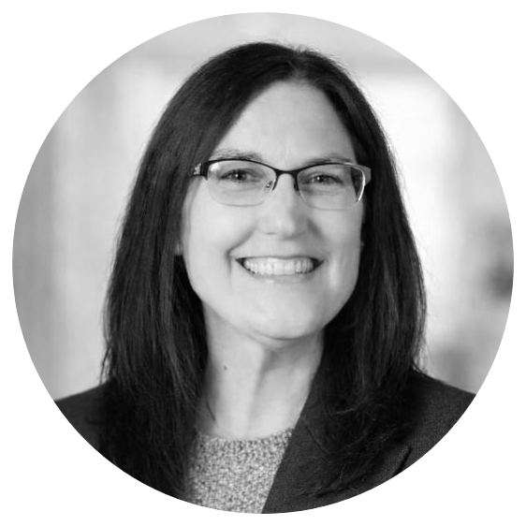
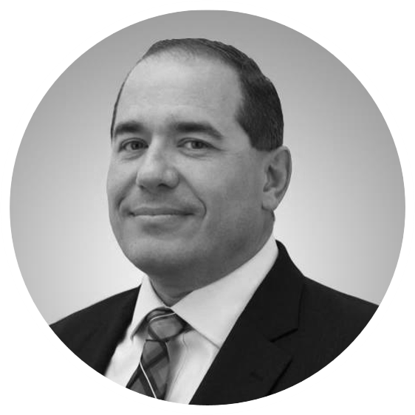

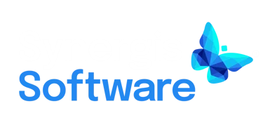

ISPE Pharma Best Practices Webinar Series
Simplifying Compliance in Life Sciences with Engineering Document Management
28 May 2026
1:00-2:00 EDT
Webinar Sponsored by:
Livia Wiley
Industry Leader
Synergis Software
John Niziolek
Director Digital Transformation Technology Services
IPS
Craig Schuler
Solutions Architect
Synergis Software

Slide 2
Getting Connected
Having trouble with sound?
Select Phone call audio option instead of Computer audio
Use a hard-wired connection instead of Wi-Fi
Disconnect and reconnect

Slide 3
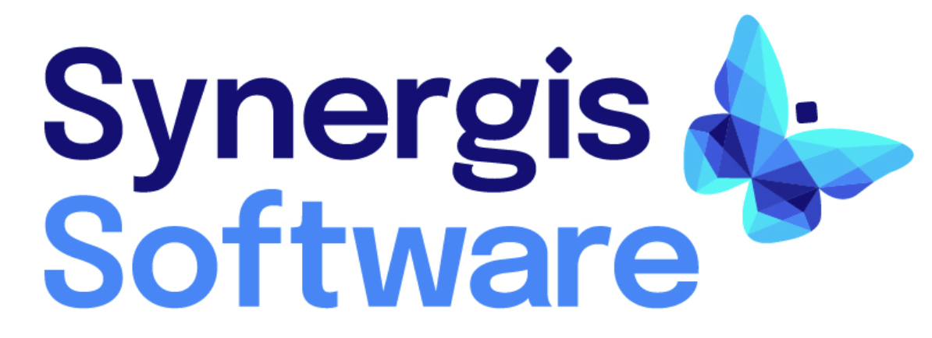
Thank You to Our Sponsor
Notes:
Ryan slide

Slide 4

Livia Wiley
Industry Leader
Synergis Software
Over 25 years in process simulation and industrial automation
Industry experience connecting complex technology to real-world impact
Work with technology providers to advance digital transformation, sustainability, and AI adoption
Create solutions that help global energy and chemical companies optimize performance

Slide 5

John Niziolek
Director
Digital Transformation Technology Services (DTTS)
20+ years of management and working experience in
commissioning, qualification, and validation of
pharmaceutical, laboratory, clinical, and R&D facilities
Strategic and practical experience applying regulatory
principles for computerized systems, data integrity, infrastructure, cloud computing, equipment, production controls, and automation platforms for clients
Leads the IPS DTTS practice as well as the Medical Gases practice

Slide 6

Craig Schuler
Solution Architect
Synergis Software
Supports sales and customer engagement efforts through technical demonstrations, webinars, and solution design
Background in helpdesk support, implementation, training, CAD drafting, and SQL/database work
brings a practical, systems-level perspective to solving complex document and workflow challenges
Works closely with engineering and operations teams to translate technical requirements into scalable EDMS solutions

Slide 7












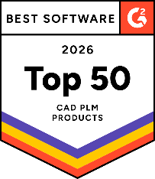
TRUSTED BY:
Who is Synergis Software?
Synergis Software is a global leader in engineering document management and workflow solutions and is the creator of Adept software.
CAD Integrations:
G2 Recognition:
35 Years
$300B
#1 Ranking
Experience in CAD and Engineering Document Management
Digital Assets Managed
Customer Service Leader in Global EDMS Market by Frost & Sullivan
Notes:
Thank you ABC for that kind introduction.
Let me give you a preview of today’s webinar, to begin by making the case for Engineering document control as a solution for attaining Simplified Compliance & System Validation. Then John will spend 10-15 minutes sharing their success implementing Synergis Adept for this specific use case at MSD. Finally, Craig will provide a product demonstration so you can see first hand the benefits of Adept.
So who is Synergis Software and what makes us an authority on this topic?
We’ve been developing, implementing and supporting engineering document management solutions for 35 years, so we have a lot of hard-earned experience.
Our flagship engineering document management system, Adept, is consistently ranked #1 in over 30 categories on G2, including best results, best ROI, highest user adoption, and best support. This year we were rewarded with the G2 2026 Best Software award win in the CAD and PLM category.
Perhaps most important, we’re trusted by many of the world’s best companies, and we’ll hear from one today.
And analyst firm Frost & Sullivan named Synergis the Customer Service Leader in the global engineering information management market.

Slide 8

Poll #1
“How confident are you that your facility’s documentation is accurate, accessible, and audit-ready?”
Very confident
Somewhat confident
Not very confident
Not confident at all
Notes:
To frame the context of this webinar, let’s begin with a question. “How confident are you that your plant’s documentation is accurate, accessible, and audit-ready?”
Let’s look at the responses:
Very confident: “Great—but is that confidence built on a governed system, or just experience and workarounds? The real question is whether that confidence holds through change, projects, and turnover.”
Somewhat confident: “This is where most organizations land—things usually work, but there’s always some uncertainty. And that uncertainty is exactly where risk and inefficiency creep in.”
Not very confident: “That lack of confidence shows up as double-checking, searching, and hesitation in the field. It’s not just inefficient—it directly impacts safety and reliability.”
Not confident at all: “When there’s no confidence, there’s no clear system of record—just conflicting versions and manual workarounds. That’s a high-risk environment, but also a clear opportunity to fix it.”
Tie / mixed results: “This tells us confidence isn’t consistent—and that’s the real problem. In industrial operations, trust in engineering information can’t vary—it has to be uniform and governed.”
Universal transition line: “Ultimately, confidence comes from control—and control comes from a trusted system of record.”

Slide 9
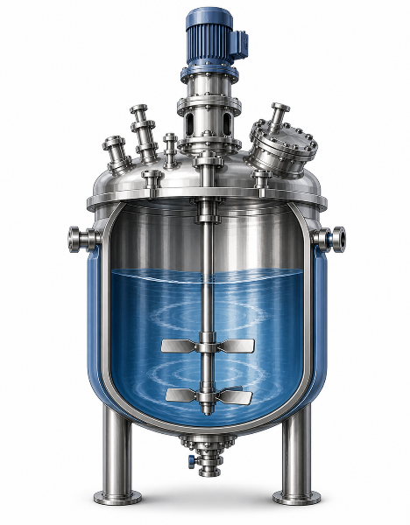
Asset Information Must Be Connected to the Physical Facility
Engineering Drawings
  Facilities are run by assets, not documents.
  Engineering documents must be linked to equipment, systems, and plant areas.
  Asset context transforms documents into usable operational information.
  This connection is foundational for maintenance, reliability, compliance, and digital initiatives.
Maintenance History
P&IDs
Inspection Records
3D Models
Specifications
Procedures
When information is connected to assets, it becomes operationally meaningful—not just stored content.
Notes:
Facilities are not run by documents—they’re run by assets.
But those assets depend on accurate, contextualized engineering information.
When drawings, models, and specifications are connected directly to equipment and systems, they become operationally meaningful. This is what enables maintenance teams to act quickly, operators to make informed decisions, and compliance teams to trust the data.
When information is connected to assets, it becomes operationally meaningful—not just stored content. Without that connection, documents are just static files—not usable production intelligence.

Slide 10
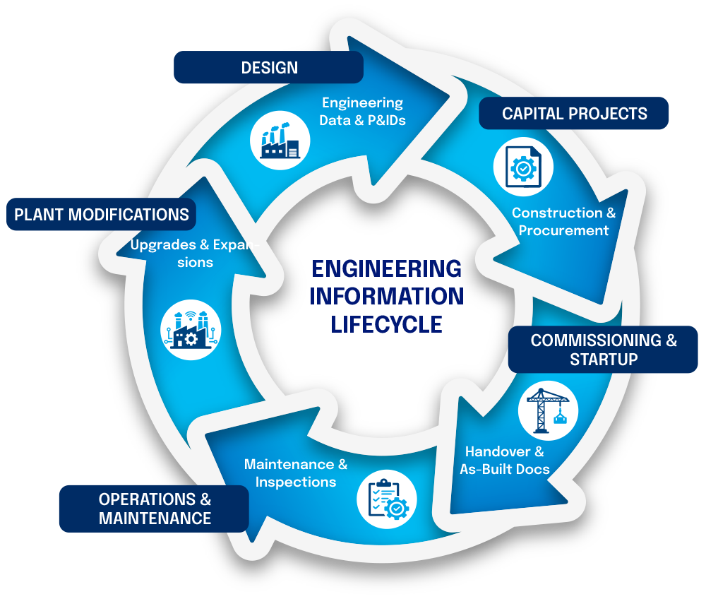
Asset Information Must Remain Trusted Across the Lifecycle
  Asset information evolves across design, construction, commissioning, operations, maintenance, and plant modifications.
  Every phase introduces change, risk, and new stakeholders.
  Without lifecycle continuity, information degrades and becomes unreliable
  Over a 30–50 year asset lifecycle, small gaps become major operational liabilities.
Notes:
Engineering information doesn’t stay static—it evolves across the entire asset lifecycle and over decades of operation.
From design to construction, commissioning, operations, and modifications, every phase introduces new data and documents, changing conditions, risk, and new stakeholders.
And over a 30 to 50 year asset life, even small gaps compound into major risks.
The key idea here is continuity. If information doesn’t flow cleanly from one phase to the next, it degrades—and eventually becomes unreliable.

Slide 11
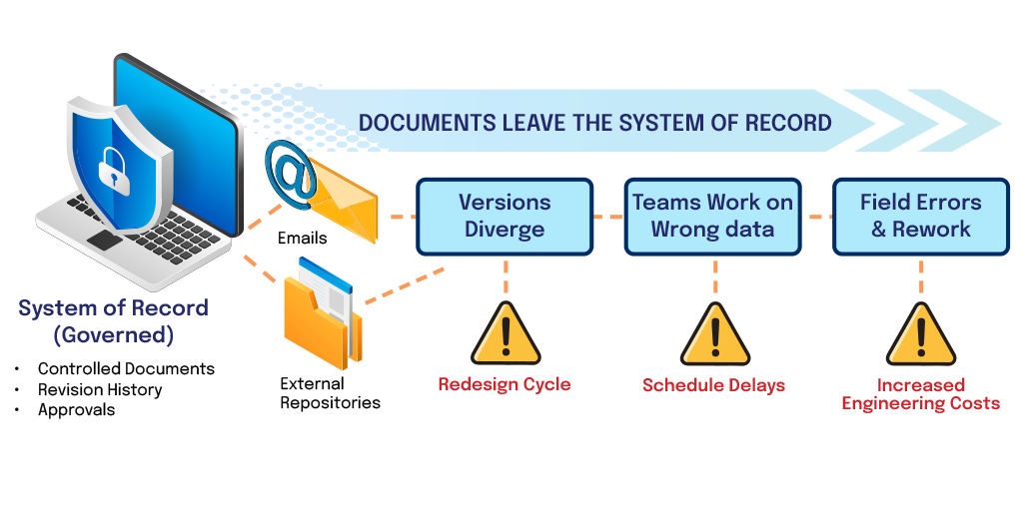
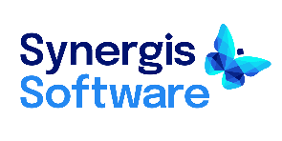
Without Proper Document Control, Project Drift Occurs
Over time, documentation no longer matches the facility.
Notes:
Here’s what typically happens in real projects.
Teams start with good information, but without proper document control, documents leave controlled systems—through email, shared drives, SharePoint downloads and revisions, or contractor workflows—versions begin to diverge.
People unknowingly work from outdated data. Inconsistency and uncertainty grows. That leads to rework, delays, field errors, and delayed handover.
This loss of control is not immediate—it begins subtly as documents move outside governed systems. Over time, this creates divergence between teams and data sources. Then documentation no longer reflects the actual plant.

Slide 12
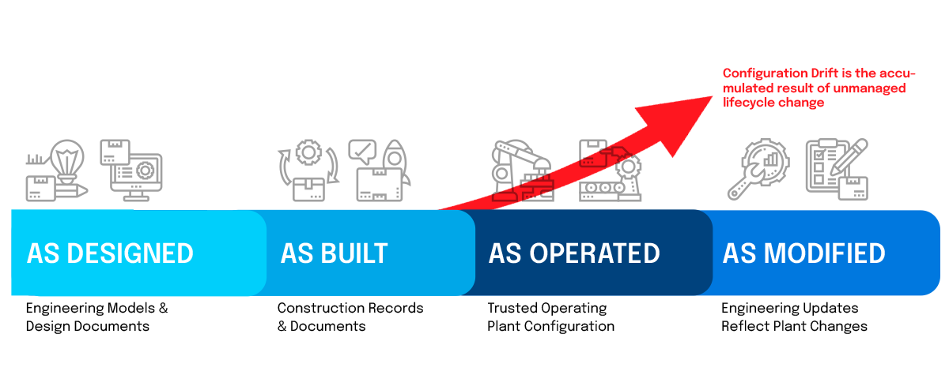
Unchecked Project Drift Leads to Configuration Drift
Over time, unmanaged project changes disconnect documentation from the physical facility.
As-designed, as-built, as-operated, and as-modified states fall out of sync.
  Safety risks
  Operational errors
  Shutdown exposure
  Compliance issues
  Costly change orders
Configuration drift is the accumulated result of unmanaged lifecycle change
Notes:
This is where project drift becomes something much bigger—configuration drift.
Now we’re no longer just talking about documents—we’re talking about a disconnect between the plant and its engineering reality.
Configuration drift is the result of unmanaged change across the lifecycle.
When as-designed, as-built, as-operated, and as-modified states fall out of sync, you introduce real risk: safety issues, operational errors, compliance failures, and costly shutdowns.

Slide 13
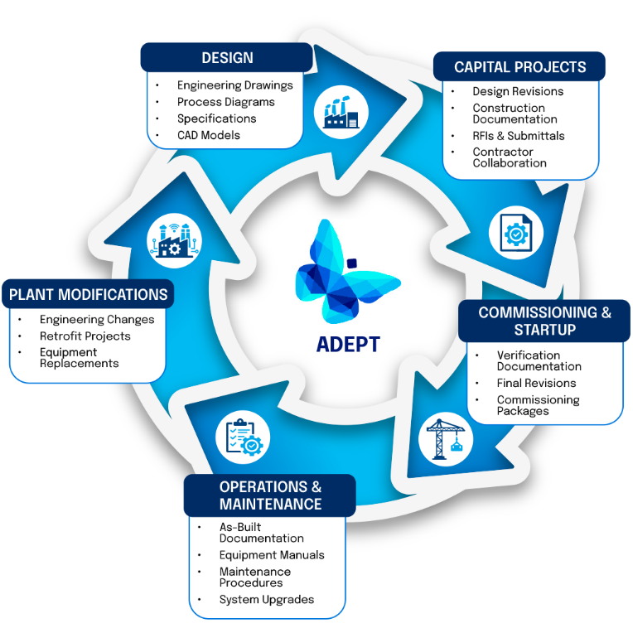
An EDMS Prevents Configuration Drift
An Engineering Document Management System (EDMS):
  Enable asset information to flow continuously across design, build, and operate
  Allow a lifecycle phase to build upon the trusted data of previous phases
  Provide a digital thread to ensure continuity without loss of control
  Keep information aligned with real-world manufacturing conditions
Notes:
This is exactly what an EDMS is designed to solve.
Engineering document management systems ensure that engineering information flows continuously across design, build, and operations—without losing control.
It also creates a digital thread, where each phase builds on trusted data from the previous one. Documents and data are neatly tied together in a single source of truth.
Most importantly, an EDMS keeps engineering information aligned with real-world plant conditions.

Slide 14
An EDMS Supports Present & Future Digital Operation
Engineering Information
  Digital twins, analytics, predictive maintenance, reliability programs, and AI all depend on accurate engineering information.
  Poor information quality undermines digital transformation initiatives
  Trusted data connects physical assets to digital intelligence
Trusted
Data
Physical
Asset
Without trusted information,
digital initiatives cannot deliver their full value.
Digital
Intelligence
Notes:
Now let’s connect this to future endeavors like digital transformation.
Digital operations like digital twins, predictive maintenance, analytics, and AI all depend on one thing—trusted engineering data. That data must be complete, validated, traceable, and contextualized.
If the underlying information to these tools is wrong or incomplete, those initiatives will fail to deliver value.
An EDMS is what connects physical assets with engineering information to digital intelligence through trusted data.

Slide 15
What “Good” Engineering Document Management Looks Like
Notes:
So what does ‘good’ actually look like in a manufacturing facility?
It means having a single, trusted source of engineering information that is accessible, controlled, and connected to assets.
It means teams can find what they need quickly, trust what they’re using, and act without hesitation.

Slide 16
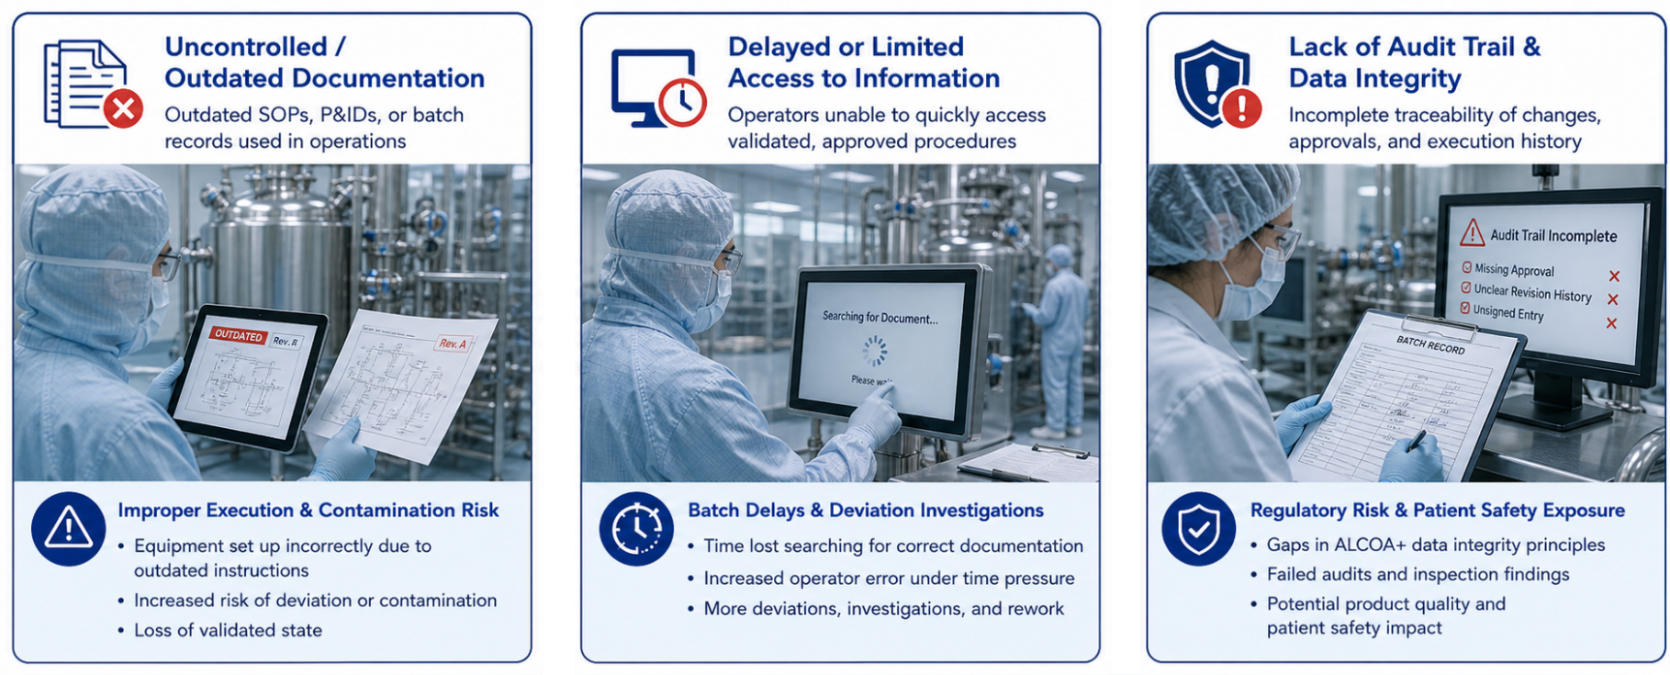



A “Good” EDMS Addresses Everyday Risks
In GxP environments, uncontrolled information is not just inefficient—it directly impacts compliance, product quality, and patient safety.
Notes:
These are the everyday risks most plants deal with.
Uncontrolled or outdated documentation…can lead to equipment being set up incorrectly, increased risk of deviation, and a loss of validated state
Delayed or limited access to information can cause delays from time lost searching for information, increased operator errors, and added rework.
And lack of an audit trail can present regulatory risks with gaps in ALCOA+, failed audits, and potential quality and safety issues.
These aren’t theoretical—they’re ongoing operational challenges.
In GxP environments, uncontrolled engineering and operational information is not just inefficient—it directly impacts compliance, product quality, and patient safety.

Slide 17
Connect
Search
Version Control
Essential Capabilities and Benefits
of an EDMS
Unify your value chain
with one source of truth.
Find the right document from anywhere, day or night.
Eliminate expensive mistakes and rework.
Workflow.
Traceability
CAD
Integration
✓ Traceability
✓ Audit Trail
✓ Record Retention
✓ Data Integrity
Automate workflow and eliminate bottlenecks.
Maintain a document Audit Trail throughout its lifecycle.
Runs in CAD, empowers design, manages file relationships.
Visualization
Security
Deployment
Enable 2D/3D view & markup without a license of CAD.
Protect your documents and intellectual property.
Enables on premise or in the cloud deployment
Notes:
An effective EDMS addresses these challenges with core capabilities.
In pharma and life sciences, it comes down to a single source for traceability, maintaining a document audit trail throughout the lifecycle, with full record retention and guaranteed data integrity.
It centralizes access to the latest approved documents, enforces version control, and provides full traceability on premise or in the cloud.
It also enables secure collaboration and integrates into engineering workflows.
The result is fewer errors, faster approvals, better compliance, and improved productivity.

Slide 18



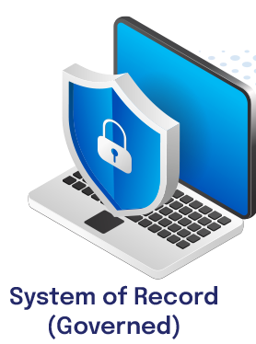

What This Looks Like in a Manufacturing Facility
❶
Engineering team creates validated documentation in the system of record
❷
Technician scans
asset tag →
Pulls correct P&ID instantly
❸
Maintenance planner accesses latest revision without calling engineering
❺
Change is captured
→
Flows back into system of record
❹
Turnaround team works from controlled, approved document set
Notes:
Let’s make this real.
The engineering team creates and maintains validated documentation (P&IDs, URS, IQ/OQ/PQ records) in the system of record that is GxP-compliant, audit-ready documentation.
So when a technician scans an asset tag, they instantly pull the correct P&ID, supporting ALCOA+ data integrity.
A maintenance planner accesses the latest revision—without calling engineering. Using the wrong version would create compliance risk + potential batch rejection.
The turnaround team responsible for the work does so from a controlled, approved set of documents, ensuring 21 CFR Part 11 and GMP compliance.
The change or changes that are made are then captured and flow back into the system of record, which serves as the backbone of regulatory compliance
This is what a true single source of truth looks like in practice.

Slide 19
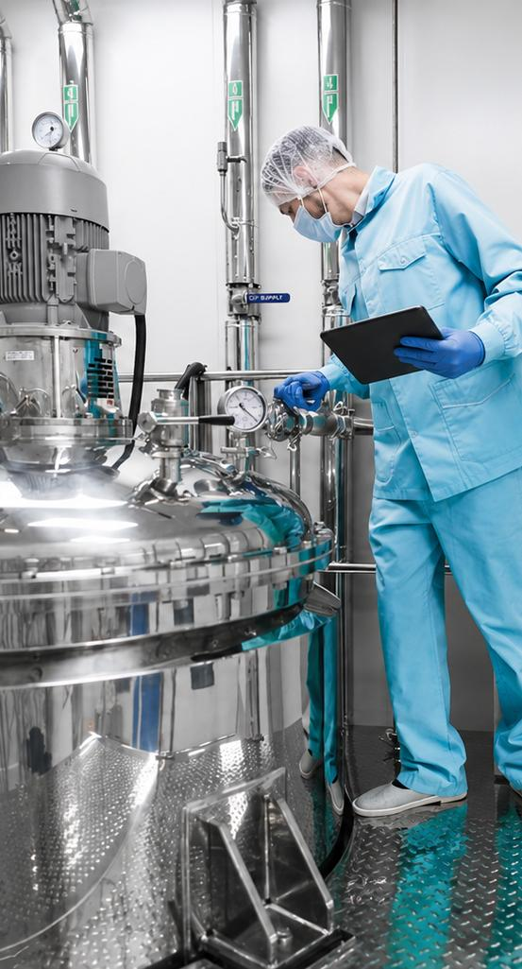
Operational Impact:
Growth & Efficiency
Reduces Waste
and Rework
Drives Innovation with Confidence
Accelerates
Project Cycles
 30% gain in workforce efficiency
Rework =
2 - 12% of
contract value
 20-25% productivity
Notes:
For growth, EDMS accelerates project cycles, helping teams deliver faster with fewer errors. It reduces waste and costly rework by keeping everyone aligned to the same information. And it creates a framework for innovation — teams can move quickly and confidently, knowing their documentation is accurate and accessible.

Slide 20
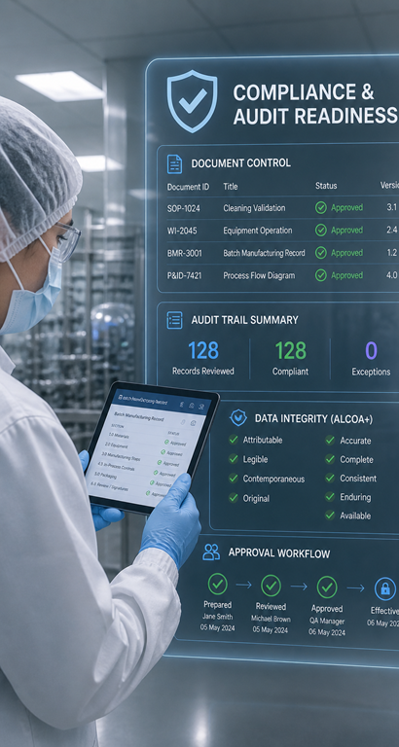
Operational Impact:
Lower Risk
Protects IP and Data Integrity
Reduces Safety Incidents
Ensures Compliance and Audit Readiness
100% traceable document history
70% of firms choose EDMS for this reason
 40% recordable incidents
Notes:
Risk reduction is a major benefit. With EDMS, you dramatically lower the chance of safety incidents because everyone has the correct, real-time documentation. You’re also better equipped for compliance audits, with full traceability at your fingertips. And finally, you’re protecting your intellectual property and ensuring data integrity, which is critical for long-term business resilience.

Slide 21

Operational Impact:
Higher Uptime
Avoids Costly Downtime from Errors
Extends Asset
Life & Boosts Reliability
Instant Access to the Correct Info for Maintenance
 < 45% of time spent retrieving docs/work orders
 30-50% downtime
 20-40%
asset life
$260K/hr cost
of unplanned downtime
Notes:
Uptime is where the rubber meets the road. Maintenance and field teams often spend hours searching for the right document. With EDMS, that information is instantly available. That means fewer delays, faster fixes, and lower costs. The result is longer asset lifecycles and a safer, more productive operation.

Slide 22
Poll #2
Which EDMS benefit is most important to you today?
Growth & efficiency (faster projects, less rework)
Risk reduction (safety, compliance)
Increased uptime (maintenance and reliability)
Asset lifecycle management (no configuration drift)
Digital thread (basis for digital initiatives)
Notes:
Growth & efficiency (faster projects, less rework): “Speed matters—but without control, faster projects just mean faster mistakes. The goal is accelerating execution with trusted, accurate information.”
Risk reduction (safety, compliance): “This is where poor information shows up fastest—safety incidents, audit gaps, and compliance risk. Strong governance is what turns documentation into a control mechanism, not a liability.”
Increased uptime (maintenance and reliability): “Uptime depends on having the right information at the right time. If maintenance teams can’t trust the data, reliability suffers.”
Asset lifecycle management (no configuration drift): “Configuration drift is what happens when change isn’t controlled. Managing the lifecycle means keeping the plant and its documentation continuously aligned.”
Digital thread (basis for digital initiatives): “Digital initiatives only work if the underlying engineering data is trusted. Without that foundation, digital twins, analytics, and AI all fall short.”
All of the above: “This is the reality—these priorities aren’t separate. Growth, risk, uptime, and digital all depend on the same foundation: trusted, governed engineering information.”
Tie / mixed results: “This shows priorities vary—but the root issue is the same. Whether it’s efficiency, risk, or uptime, they all depend on how well engineering information is controlled.”
Universal transition line: “No matter the priority, the common thread is this: better outcomes start with trusted engineering information.”

Slide 23



Merck’s Global Engineering Document Management Deployment

Slide 24
Who is MSD?
  Global Leader in the development and manufacturing of medicines, vaccines, biologic therapies, and animal health products.
  Headquarters: Rahway, New Jersey, U.S.
  Revenue: US $48.70 billion (2021)
  Number of employees: 68,000 (2021)

Slide 25
Background and Scope
MSD needed a centralized, validated system to:
Funding was approved following a near-miss safety issue
Store CAD-related files
Ensure version control
Create and use workflows
Segregate different sites’ data
CAD files represent the entirety of a company site including:
Facility, floor plans, construction, manufacturing, above ground, utilities, etc.
Users include:
Maintenance users
Engineers designing and revising
Various support organizations that use drawings for business needs.
Current scope:
United States and Ireland
Expansion to other global sites
Notes:
MSD needed:
Needed a central, validated system to store CAD related file that could maintain version control, use work flows, with the ability to segregate different sites data.
Target users included maintenance end users, engineering doing design and updates, and various support organizations that utilized the drawings for business needs.
CAD files encompassed the entirety of any company site – facility, floor plans, construction, manufacturing, above ground, utilities, etc.
Current scope is the United States and Ireland. Expansion to other sites is planned over the next few years.

Slide 26
Legacy System Challenges
  Legacy system had been installed over a decade earlier (Windows XP based)
  The customization has negatively impacted system performance since it was first implemented.
  The company discontinued vendor support in order to reduce costs.
  The support infrastructure was outdated.
  Unable to function on Windows 10 computers
Notes:
Legacy system had been installed over a decade earlier (XP based)
Customization had degraded it from day one.
Company had discontinued vendor support to reduce costs
Support infrastructure was obsolete
Unable to function on Windows 10 computers

Slide 27
Approach to Solution Provider Selection
  Polled several Engineering & CAD teams in US, EMEA, Asia-Pacific
  Developed user requirements with a core team of six power users
  Sent questionnaires to multiple solution providers
  Participated in application demos for top two contenders
  Interviewed solution provider customer references
  Selected Synergis as best at meeting requirements with excellent customer references
Notes:
Polled several Engineering and CAD teams in US, EMEA, and Asia-Pacific for general input
Small core team of 6 power users developed user requirements based in the input received
Sent questionnaires (based on requirements) to multiple vendors
Participated in application demonstrations for two top contenders.
Eventually Synergis was selected as they best met the requirements and had good customer references.

Slide 28
The Criteria
Baseline criteria
  21 CFR Part 11 compliant
  Full audit trail
  File Type Support for most formats
  Support multiple versions of AutoCAD & MicroStation
  Display/Track versioning
  Logical Variables
  Configurable workflows
  Bulk import capabilities
  Bulk export capabilities
  Check out files to a project
  Quality customer support
Displays and/or resolves:
  Dynamic Cross Reference Files
  Static Cross Reference Files
  Nested Cross References
  Circular Cross References
Resolves drawings with:
  Model/Paper Space Tabs
  Sheet File Management
  Level/Layer, Color
  Weight/Thickness
  Object Linking and Embedding (OLE)
  Custom Line types
  Stacked Fractions
  Tags & Attributes
Notes:
21 CFR Part 11 compliant
Full audit trail
File Type Support – most formats
Support for multiple versions of AutoCAD and Microstation
Display/track versioning
Logical Variables
Able to display and/or resolve: Dynamic Cross Reference Files; Static Cross Reference Files; Nested Cross References, Circular Cross References
Resolve drawings with: Model/Paper Space Tabs; Sheet File Management; Level/Layer, Color, Weight/Thickness; Object Linking and Embedding (OLE); Custom Line types; Stacked Fractions; Tags & Attributes
Configurable workflow
Bulk Import Capabilities
Bulk Export Capabilities
Check out files to a project
Customer support quality

Slide 29
Approach to Adept Implementation & Migration
Adept Installation & Configuration
Legacy Data Migration
  Server configuration
  Application configuration
  Data Card development for Human Health & Animal Health
  Two sources of data: shared drive and legacy system
  Eventually legacy system migration split off into a separate project
Adept Training
  Administrator Training
  User Training
  Developed Training Materials

Slide 30
Approach to Validation
Needed to meet internal system document lifecycle:
Needed a partner to execute it all!
  Selected IPS based on an internal reference and Synergis recommendation
  IPS managed the project, wrote all the project documentation and wrote the test scripts
  Risk Profiles: Privacy, Information, and HR Data Risk Assessments
  Quality Assurance Plan
  Requirement and Design Specifications
  Qualification
  Test Scripts
  Test Execution
  Project Management
Notes:
Needed to meet internal system document life cycle:
Risk profiles: Privacy, Information, and HR Data Risk Assessments
Quality Assurance Plan
Requirement and Design Specifications
Qualification
Test Scripts
Test Execution
Project Management
And needed to find a partner to execute it all!
Based on an internal reference and Synergis recommendation, IPS was selected

Slide 31
Approach to Validation
Risk Profiles (Privacy, Information, HR)
Quality Assurance Plan
Specifications (Requirements, Design, & Testing)
Traceability Matrix
Vulnerability
Scans
Development Summary Report
Installation Qualification
User Acceptance Testing
Change
Record
Release to Production
Quality Assurance Summary Report
Notes:
This is a simplified flow diagram of what was internally required to “stand up” a new software package.

Slide 32
Lessons Learned
  Communication is critical, especially as it related to degrees of data accuracy
  Synergis could have accessed the data earlier to address issues for future migrations, which is key to future success.
  The MSD business team could have been involved earlier in core testing and configuration requirements.
  We could have conducted more thorough due diligence during the Design and Data Migration phases of the project, particularly regarding testing.
  Having the IPS team engaged and familiar with the company’s processes proved to be invaluable.
Notes:
Trouble arose was during the Data Migrations - multiple iterations for the legacy files were extremely painful and expensive for everyone.
There were some miscommunications regarding degrees of accuracy until the Synergis and MSD teams began to communicate more clearly.
Getting Synergis hands on the data earlier to address issues for future migrations is a key to future success.
More due diligence in the Design and Data Migration phases of the project was needed, including the depth and breadth of the testing that really was not well understood.
The business side should have been involved earlier on with the core testing and configuration requirements.
Having the vendor personnel (IPS) already familiar with the company’s processes was invaluable.

Slide 33
Benefits
  Version control improved the compliance risk profile
  Adept became the centralized source of the truth
  Workflow can be easily customized based on need
  A modern system that meets the changing needs of the business
  Validated to meet cGMP requirements
Notes:
Increased compliance risk profile due to maintaining version control
Centralized source of the truth
Workflow could be customized based on the need
Modern system that support the evolving requirements of the business
Validated to meet cGMP requirements

Slide 34


IPS-Integrated Project Services
Digital Transformation & Technology Services

Slide 35
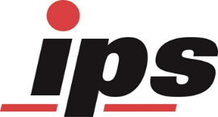
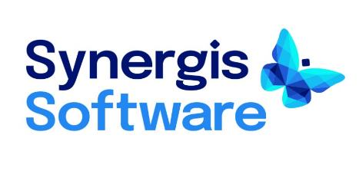
IPS Collaborative Services
The Partnership:
IPS has supported Synergis Adept implementation projects for many of our shared clients. IPS has developed a deep understanding of the Adept platform and the Synergis implementation process.
What does this mean:
This partnership provides every client with a compliant, consistent implementation experience.
Our clients benefit from adoption of industry leading technology and the assurance that their regulatory compliance concerns are being addressed and met.

Slide 36

IPS / Merck Partnership
Background:
IPS has been a long-time provider of CQV services for Merck, MSD, and their affiliated companies across all business areas and operations.
The request:
Through referrals from both Synergis and internal Merck staff, IPS was engaged to provide validation and compliance support for the Synergis Adept implementation project.

Slide 37
Compliance Challenges with EDMS Platforms
  Meeting current regulatory compliance requirements for Electronic Records and Signatures (ERES -21 CFR Part 11, Annex 11) and Regulatory guidance for Data Integrity (DI)
  Management of Change within the platform and (system) and for data (records)
  System security
  Audit, Traceability and Reporting
  Integrity of records / data
Contemporaneous
Legible
Original
ALCOA++
Attributable
Accurate
Complete
Available
Consistent
Enduring
Traceable

Slide 38
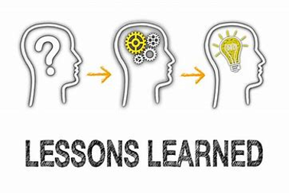
Merck Adept Project Experiences
IPS Lessons Learned
  Early engagement at all levels
  Utilize resources familiar with Client process and systems
  Understanding User and Business requirements
  Design, Plan, and Test … and re-test
  Shared communication platforms
  Data Migration and translation

Slide 39
Complete Asset Lifecycle Management by Adept
More Than Engineering Document Control and Compliance
Notes:
So far, we’ve talked about the problem and what good looks like.
Now let’s talk about how this is actually achieved—with Adept.

Slide 40
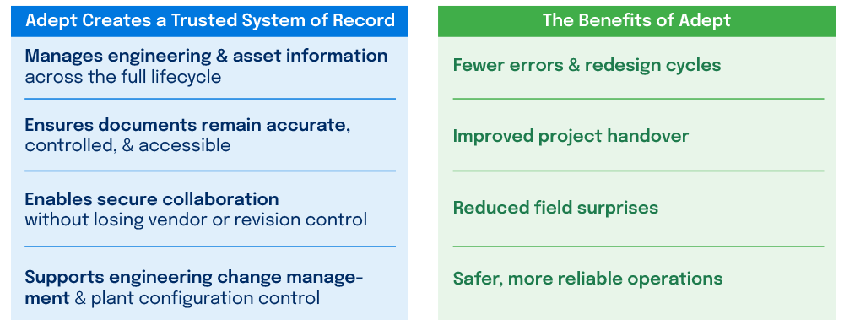
Your Trusted System of Record for Document Control & Compliance
Notes:
Adept ensures that documents are not just stored, but remain accurate, controlled, and accessible. That means when someone pulls a drawing or a spec, they can trust it reflects the current state of the plant.
It also enables secure collaboration—especially important when you have contractors and external partners involved—without losing revision control or introducing version risk.
And critically, it supports engineering change management and plant configuration control. That’s what prevents configuration drift and keeps the physical plant aligned with its engineering definition.
When you get that level of control, you unlock tremendous benefits.
You reduce errors and redesign cycles because teams are no longer working off outdated or conflicting information.
You improve project handover because engineering data transitions cleanly from projects into operations.
You reduce field surprises—fewer unexpected issues during startup or maintenance—because what’s on paper matches reality.
And ultimately, you enable safer, more reliable operations because decisions are based on trusted, governed engineering information.
When engineering information is controlled, connected, and trusted, operational performance follows.

Slide 41
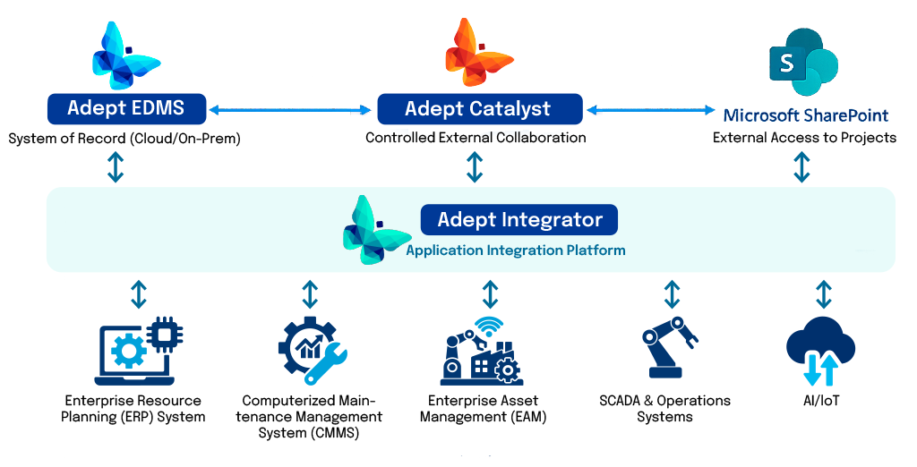
Adept: For Complete Asset Lifecycle Management
Adept is your engineering system of record
for complete asset lifecycle management
Notes:
Synergis Software didn’t stop at engineering document control. We also created Adept Catalyst and Adept Integrator to facilitate complete asset information lifecycle management, improving collaboration and systems integration.

Slide 42
Adept: For Complete Asset Lifecycle Management
Adept Catalyst for controlled access through SharePoint
Ensures the right information
is shared with the right stakeholders
Governs how updated documents return through review, approval, and version control
Improves project execution and handover quality with reduced rework & closeout risk
Notes:
Capital projects require collaboration with contractors, suppliers, and external engineering partners. While some customers use Adept for this, others require SharePoint.
Adept Catalyst turns external collaboration with SharePoint into a controlled extension of the engineering system of record. It controls what documents go out to projects and ensures updates come back through review, approvals, and version control—so projects move faster and operations receives clean, reliable engineering documentation.
Adept Catalyst accelerates project execution while preserving documentation integrity, reducing operational risk, rework, and closeout surprises.

Slide 43
Adept: For Complete Asset Lifecycle Management
Adept Integrator for
systems integration:
Connects Adept with systems to eliminate data silos
Automates workflows
and data exchange across applications
Reduces manual effort, errors, and delays between systems
Keeps systems synchronized with accurate, up-to-date information
Notes:
Adept Integrator for systems application integration:
Connects Adept with business systems like ERP, CMMS, EAM, and SCADA to eliminate data silos
It automates workflows and data exchange across applications
Reduces manual effort, errors, and delays between systems
Keeps systems synchronized with accurate, up-to-date information
Integrator offers out of the box connectors to leading platforms like Adept, SAP, Maximo, and Oracle P6.

Slide 44
Product Demo

Slide 45
Wrap Up

Slide 46


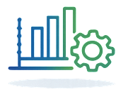
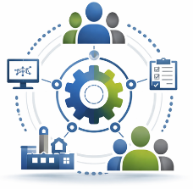
Engineering Document Control Becomes Your Strategic Advantage
Engineering information defines how a plant operates
Poor control creates real plant risk
Facilities that implement asset information lifecycle management with a single trusted source for engineering document control gain:
More efficient projects
Safer, more compliant, & reliable operations
Better performance
& compliance
Enables digital operations
Notes:
The combination of Adept, Adept Integrator, and Adept Catalyst is your strategic advantage for trusted asset information.

Slide 47
Contact Information
Upcoming Webinars
Igniting Digital Transformation: Intro to the Holistic Digital Enablement Good Practice Guide — Series Kickoff (Part 1 of 4)
Thursday, 11 June
2026 State of Validation: Accelerating Digital Maturity in the Age of AI
Tuesday, 16 June
AI in Regulated Environments: What Agencies Are Saying, Where It's Failing, and What to Watch For
Thursday, 18 June
Beyond the Pilot: Business Impacts of LLMs in Quality and Regulatory Applications
Thursday, 25 June
On Demand Webinars Now Available visit ISPE.org/webinars for the full calendar
Livia Wiley
Industry Leader
Synergis Software
livia.wiley@synergis.com
Craig Schuler
Solutions Architect
Synergis Software
craig.schuler@synergis.com
John Niziolek
Director Digital Transformation
Technology Services
IPS - Integrated Project Services, LLC.
jniziolek@ipsdb.com
Topic Ideas or Feedback?
Send to ispeak@ispe.org

Slide 48
ISPE Membership Highlights
FREE online access to 20+ ISPE Good Practice Guides
Join a global network of more than 25,000 professional peers from over 120 countries working to advance solutions that improve patient health
Receive discounted registration rates, saving you hundreds of dollars on ISPE conferences
Enjoy member benefits including:
  Opportunities to volunteer at any level, such as joining program committees, contributing iSpeak blog posts, or providing peer reviews for ISPE Guidance Documents before publication
  Access to join Communities of Practice (CoP) and network with other members of ISPE through ISPE Engage
  Access to the ISPE Career Center for job searches and career resources
  Engage with the Pharmaceutical Engineering® Magazine
  And much more

